Slide 1
What can we do with TypeScript 2.5?
Presenter: Trong Tran
09 - 2017

Slide 2
Agenda
Introduction JavaScript and ECMAScript
Introduction TypeScript
Setting up TypeScript working environment
Getting started with TypeScript
What can we do with TypeScript 2.5?
Demo

Slide 3
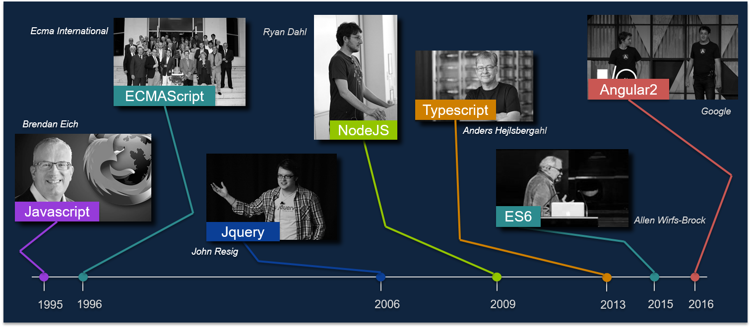
Figure 1 - The milestone of libs/ frameworks invented

Slide 4
1. Introduction JavaScript and ECMAScript

Slide 5
1.1 JavaScript
JavaScript is the programming language, which is use to program the behavior of web pages.
JavaScript code can run locally in a user's browser (rather than on a remote server), the browser can respond to user actions quickly, making an application more responsive. Furthermore, JavaScript code can detect user actions that HTML alone cannot, such as individual keystrokes.
To Browser execute JavaScript code, the browser need to by default included JavaScript engine (also known as JavaScript interpreter or JavaScript implementation) is an interpreter that interprets JavaScript source code and executes the script accordingly.

Slide 6
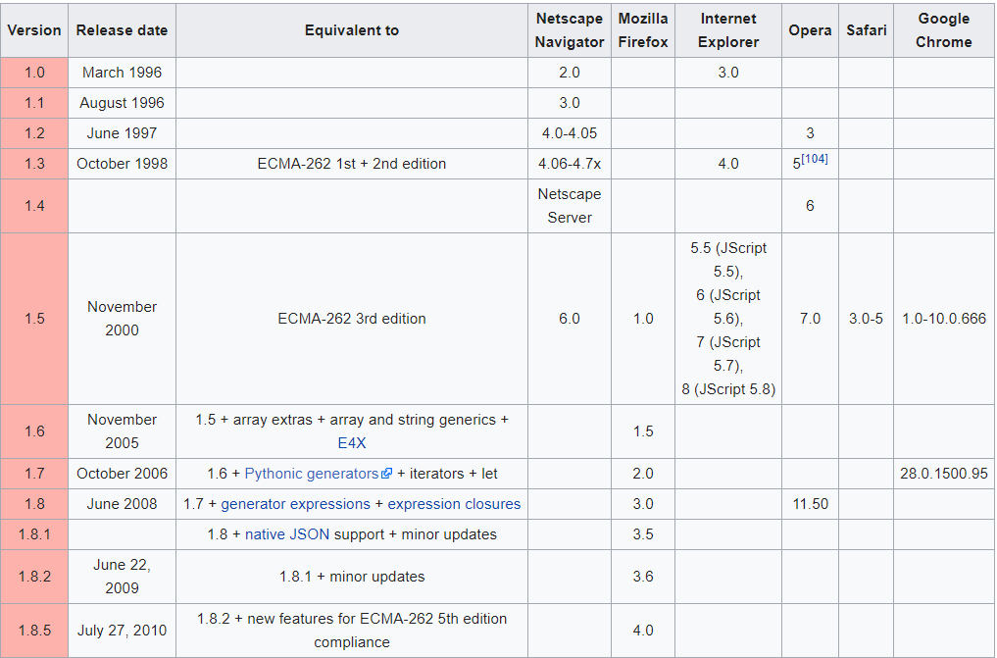
1.1 JavaScript
Figure 2 – Release version history

Slide 7
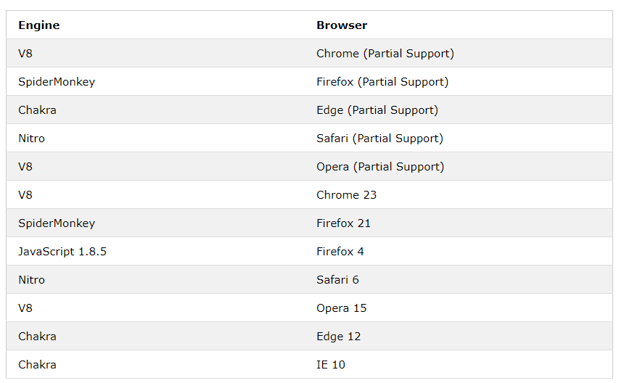
1.1 JavaScript
Figure 3 – Supported JavaScript engine in Browser

Slide 8
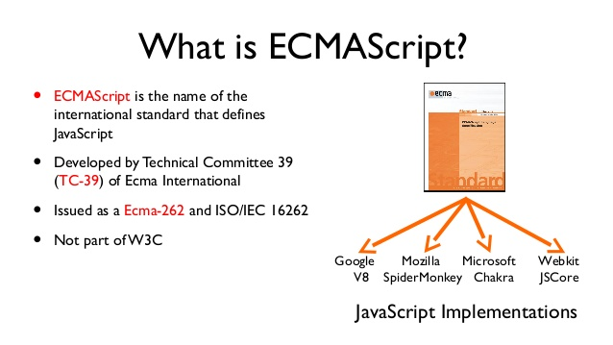
1.2 ECMAScript

Slide 9
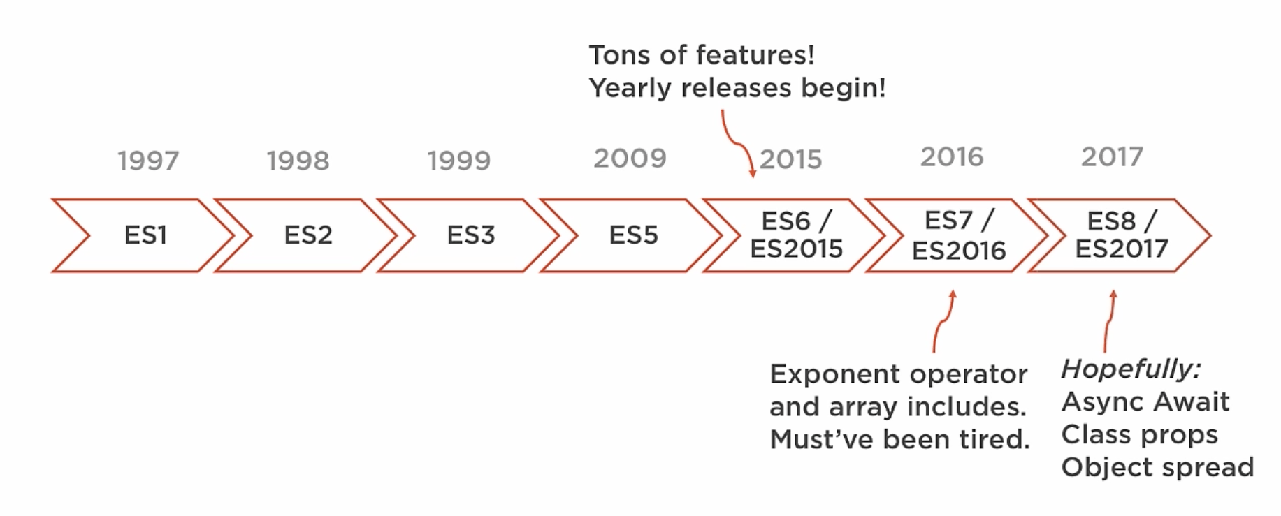
1.2 ECMAScript
Figure 4 – ECMAScript Editions

Slide 10
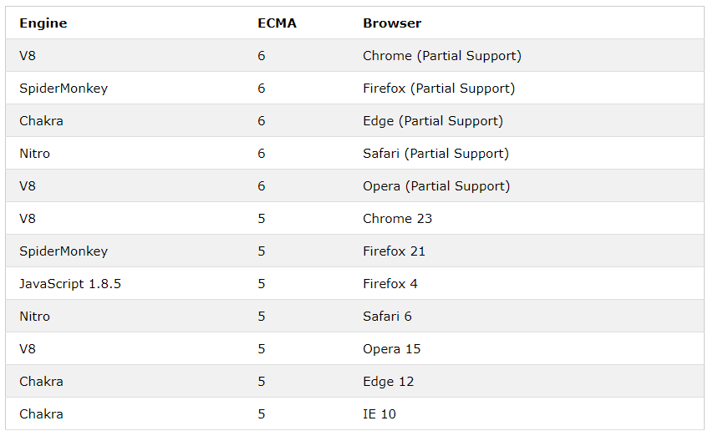
1.2 ECMAScript
Figure 4 – ECMAScript Browser Implementations

Slide 11
2. Introduction TypeScript
TypeScript is a free and open-source programming language developed and maintained by Microsoft. It is a strict syntactical superset of JavaScript, and adds optional static typing to the language. Anders Hejlsberg, lead architect of C# and creator of Delphi and Turbo Pascal, has worked on the development of TypeScript.
TypeScript may be used to develop JavaScript applications for client-side or server-side execution.

Slide 12
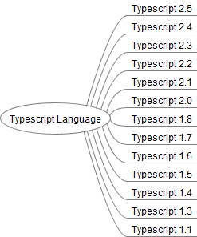
2. Introduction TypeScript
Figure 5 – TypeScript Editions

Slide 13
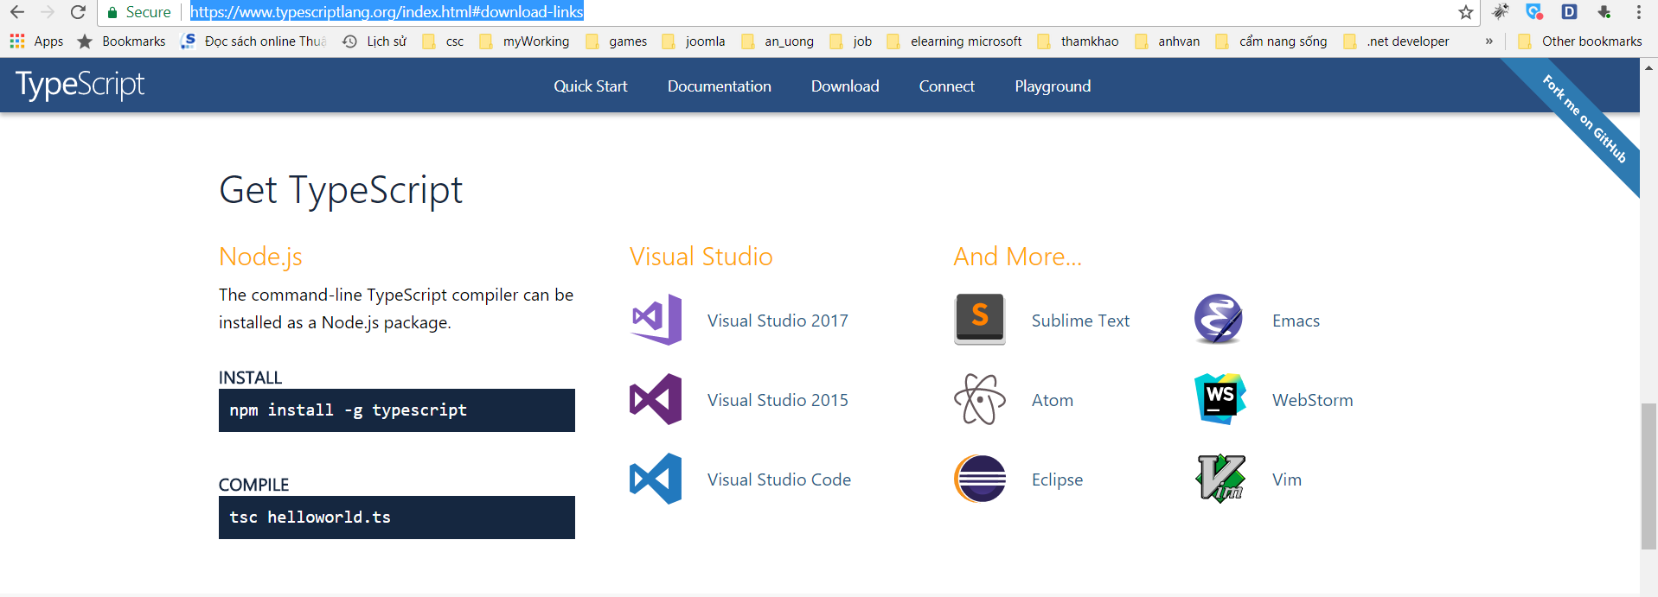
3. Setting up TypeScript working environment
Installing TypeScript:
There are two main ways to get the TypeScript tools:
Via npm (the Node.js package manager). (Download Node.js)
By installing TypeScript’s Visual Studio plugins. (Download TypeScript Visual Studio plugins)
Figure 6 – Site download TypeScript
Recommended install TypeScript Via npm
(the Node.js package manager)
For NPM users:
> npm install -g typescript

Slide 14
3. Setting up TypeScript working environment
TypeScript Editor Support (recommended use Visual Studio Code):
alm.tools
Atom
CATS
Eclipse
Emacs
NeoVim
NetBeans
Notepad++
Sublime Text
Vim
Visual Studio
Visual Studio Code
WebStorm

Slide 15
3. Setting up TypeScript working environment
Integrating with Build Tools
Browserify
Duo
Grunt
Gulp (Quick learn about Gulp automation task build: Link)
Jspm
Webpack
MSBuild
NuGet

Slide 16
3. Setting up TypeScript working environment
Using tsconfig.json
By invoking tsc with no input files, in which case the compiler searches for the tsconfig.json file starting in the current directory and continuing up the parent directory chain.
By invoking tsc with no input files and a --project (or just -p) command line option that specifies the path of a directory containing a tsconfig.json file, or a path to a valid .json file containing the configurations.

Slide 17
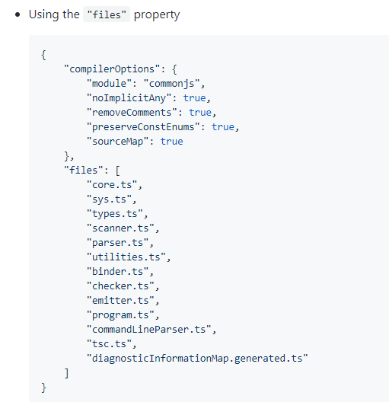
3. Setting up TypeScript working environment

Slide 18
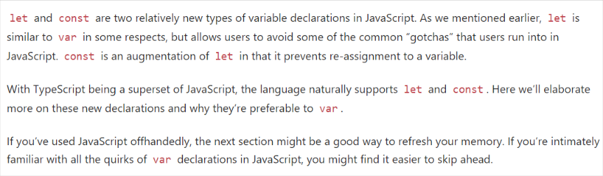
4. Get started with TypeScript
4.1 Variable Declarations

Slide 19
4. Get started with TypeScript
Const example:
const numLivesForCat = 9;
const kitty = {
name: "Aurora",
numLives: numLivesForCat,
}
// Error
kitty = { name: "Danielle", numLives: numLivesForCat };
// all "okay"
kitty.name = "Rory";
kitty.name = "Kitty";
kitty.name = "Cat";
kitty.numLives--;
Let example:
let hello = "Hello!";

Slide 20
4. Get started with TypeScript
4.1 Basic Types:
Boolean
The most basic datatype is the simple true/false value, which JavaScript and TypeScript call a boolean value.
let isDone: boolean = false;
Number
TypeScript also supports binary and octal literals introduced in ECMAScript 2015.
let decimal: number = 6;
let hex: number = 0xf00d;
let binary: number = 0b1010;
let octal: number = 0o744;
String
We can use template strings, which can span multiple lines and have embedded expressions. These strings are surrounded by the backtick/backquote (`) character, and embedded expressions are of the form ${ expr }
let fullName: string = `Bob Bobbington`;
let age: number = 37;
let sentence: string = `Hello, my name is ${ fullName }. I'll be ${ age + 1 } years old next month.`;
This is equivalent to declaring sentence like so:
let sentence: string = "Hello, my name is " + fullName + ".\n\n" + "I'll be " + (age + 1) + " years old next month.";

Slide 21
4. Get started with TypeScript
Array
TypeScript, like JavaScript, allows you to work with arrays of values. Array types can be written in one of two ways. In the first, you use the type of the elements followed by [] to denote an array of that element type:
let list: number[] = [1, 2, 3];
The second way uses a generic array type, Array<elemType>:
let list: Array<number> = [1, 2, 3];
Tuple
Tuple types allow you to express an array where the type of a fixed number of elements is known, but need not be the same. For example, you may want to represent a value as a pair of a string and a number:
Tuple types allow you to express an array where the type of a fixed number of elements is known, but need not be the same. For example, you may want to represent a value as a pair of a string and a number:
// Declare a tuple type
let x: [string, number];
// Initialize it
x = ["hello", 10]; // OK
// Initialize it incorrectly
x = [10, "hello"]; // Error

Slide 22
4. Get started with TypeScript
When accessing an element with a known index, the correct type is retrieved:
console.log(x[0].substr(1)); // OK console.log(x[1].substr(1)); // Error, 'number' does not have 'substr'
When accessing an element outside the set of known indices, a union type is used instead:
x[3] = "world"; // OK, 'string' can be assigned to 'string | number'
console.log(x[5].toString()); // OK, 'string' and 'number' both have 'toString'
x[6] = true; // Error, 'boolean' isn't 'string | number‘
Enum
A helpful addition to the standard set of datatypes from JavaScript is the enum. As in languages like C#, an enum is a way of giving more friendly names to sets of numeric values.
enum Color {Red, Green, Blue}
let c: Color = Color.Green;

Slide 23
4. Get started with TypeScript
By default, enums begin numbering their members starting at 0. You can change this by manually setting the value of one of its members. For example, we can start the previous example at 1 Instead of 0:
enum Color {Red = 1, Green, Blue}
let c: Color = Color.Green;
Or, even manually set all the values in the enum:
enum Color {Red = 1, Green = 2, Blue = 4}
let c: Color = Color.Green;
A handy feature of enums is that you can also go from a numeric value to the name of that value in the enum. For example, if we had the value 2 but weren't sure what that mapped to in the Color enum above, we could look up the corresponding name:
enum Color {Red = 1, Green, Blue}
let colorName: string = Color[2];
alert(colorName);

Slide 24
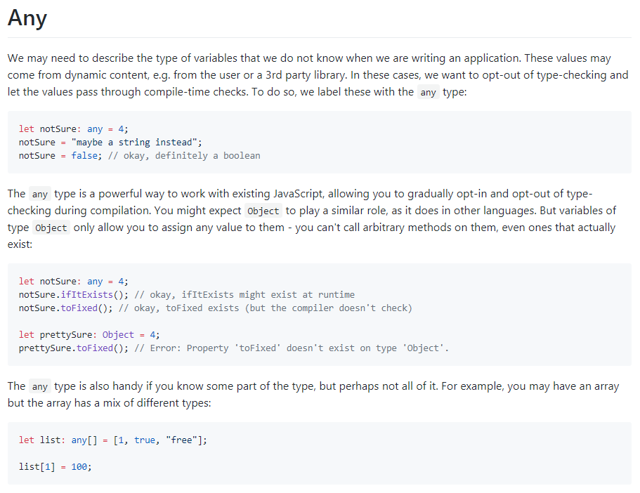
4. Get started with TypeScript

Slide 25
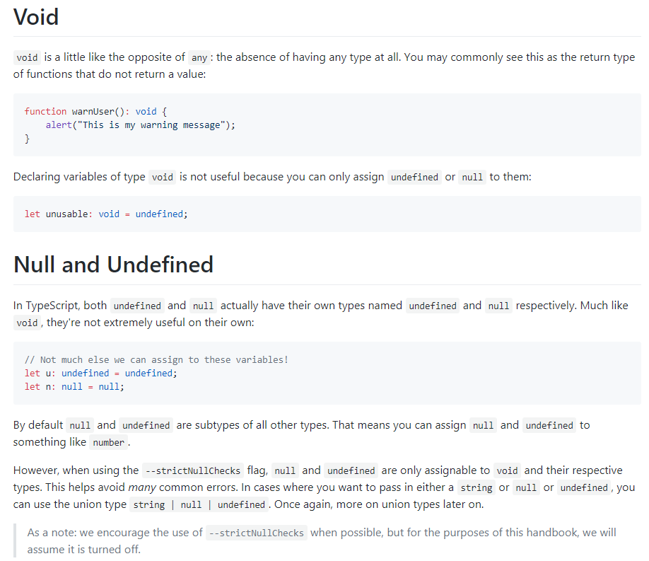
4. Get started with TypeScript

Slide 26
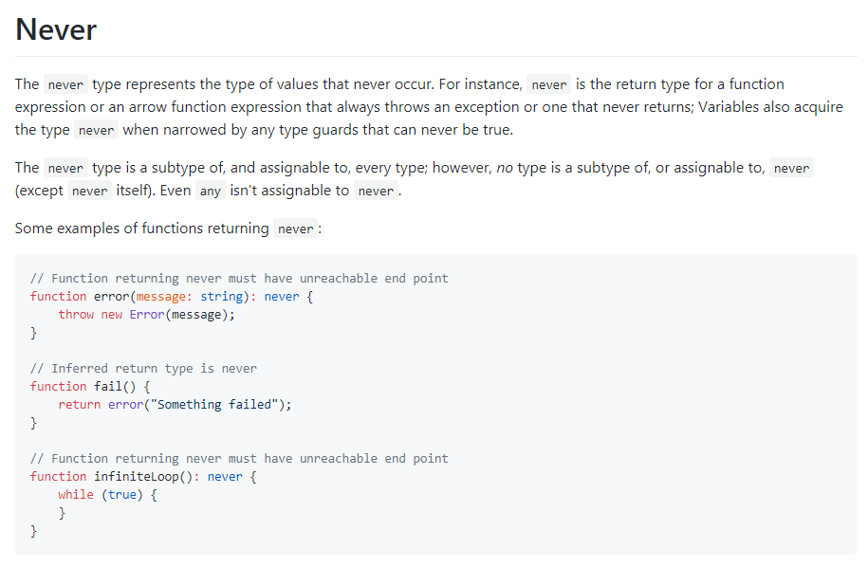
4. Get started with TypeScript

Slide 27
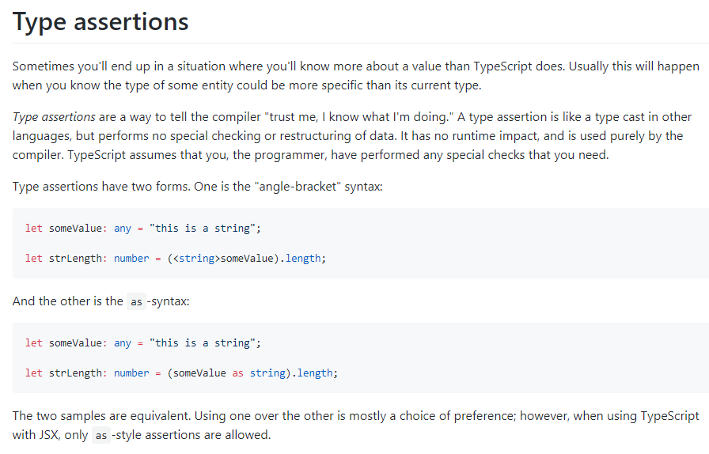
4. Get started with TypeScript

Slide 28
4. Get started with TypeScript
4.2 Interface
interface ClockInterface {
currentTime: Date;
}
class Clock implements ClockInterface {
currentTime: Date;
constructor(h: number, m: number) { }
}

Slide 29
4. Get started with TypeScript
4.3 Classes
class Greeter {
greeting: string;
constructor(message: string) {
this.greeting = message;
}
greet() {
return "Hello, " + this.greeting; }
}
let greeter = new Greeter("world");

Slide 30
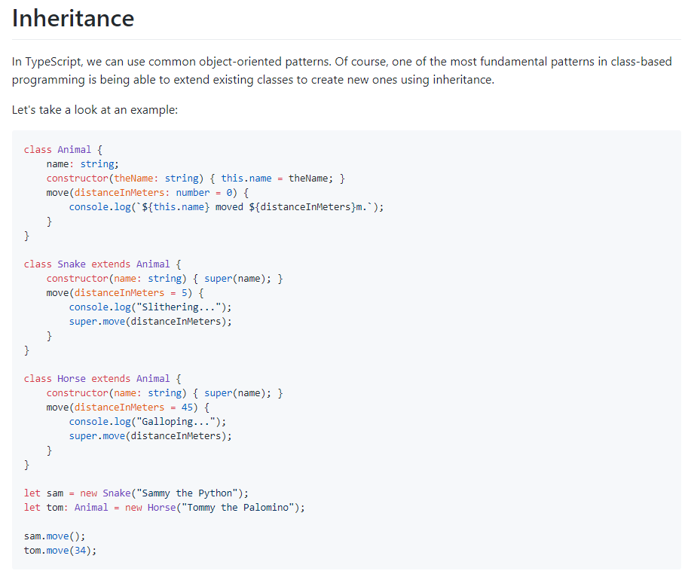
4. Get started with TypeScript

Slide 31
4. Get started with TypeScript
4.4 Using Namespaces
Namespaces are simply named JavaScript objects in the global namespace. This makes namespaces a very simple construct to use. They can span multiple files, and can be concatenated using --outFile. Namespaces can be a good way to structure your code in a Web Application, with all dependencies included as <script> tags in your HTML page. Just like all global namespace pollution, it can be hard to identify component dependencies, especially in a large application.
4.5 Using Modules
Just like namespaces, modules can contain both code and declarations. The main difference is that modules declare their dependencies.
Modules also have a dependency on a module loader (such as CommonJs/Require.js). For a small JS application this might not be optimal, but for larger applications, the cost comes with long term modularity and maintainability benefits. Modules provide for better code reuse, stronger isolation and better tooling support for bundling.
It is also worth noting that, for Node.js applications, modules are the default and the recommended approach to structure your code.
Starting with ECMAScript 2015, modules are native part of the language, and should be supported by all compliant engine implementations. Thus, for new projects modules would be the recommended code organization mechanism.

Slide 32
4. Get started with TypeScript
4.6 Functions
To begin, just as in JavaScript, TypeScript functions can be created both as a named function or as an anonymous function. This allows you to choose the most appropriate approach for your application, whether you're building a list of functions in an API or a one-off function to hand off to another function.
To quickly recap what these two approaches look like in JavaScript:
// Named function
function add(x: number, y: number): number {
return x + y;
}
// Anonymous function
let myAdd = function(x: number, y: number): number {
return x + y;
};
Just as in JavaScript, functions can refer to variables outside of the function body. When they do so, they're said to capturethese variables. While understanding how this works, and the trade-offs when using this technique, are outside of the scope of this article, having a firm understanding how this mechanic is an important piece of working with JavaScript and TypeScript.
let z = 100;
function addToZ(x, y) {
return x + y + z;
}

Slide 33
4. Get started with TypeScript
4.7 Generic
class GenericNumber<T> {
zeroValue: T;
add: (x: T, y: T) => T;
}
let stringNumeric = new GenericNumber<string>();
stringNumeric.zeroValue = "";
stringNumeric.add = function(x, y) { return x + y; };
alert(stringNumeric.add(stringNumeric.zeroValue, "test"));

Slide 34
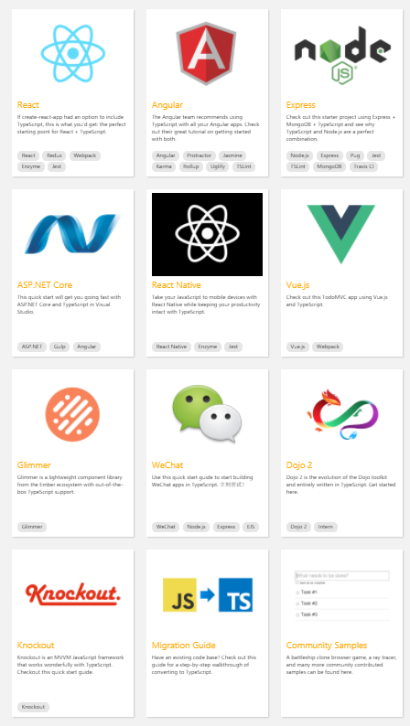
5. What can we do with TypeScript 2.5?
List of framework/ server-side which are use TypeScript
as programming language (Refer)

Slide 35
6. Demo

Slide 36
Q&A ???
Thank you!

